Slide 1
Adiba Binte Amin
B B A Marketing ( I U B )

Slide 2
About Me
To become a dynamic & versatile person who is capable of merging innovative ideas and getting me into the corporate environment where honesty, creativity, punctuality, and diligence are the cornerstone of success.

Slide 3
Skills & expertise
Photography
Video Editing
Leadership
Digital Marketing
Content Writing
Verbal & nonverbal Communication

Slide 4
Employment history
Library Assistant (LA)
Independent University (IUB), Bashundhara, Dhaka
January 2020 - May 2021
Assistant Digital Marketing
Officer (Part-Time)
Wholesale Express BD Ltd. Uttara, Dhaka.
September 2021 - August 2023
Content Writer (Part-Time)
Linear IT Solution, Baridhara, Dhaka.
May 2021 - August 2023
Sr. Project Manager
Baby Care Shop, Dhaka
September 2023 - Present

Slide 5


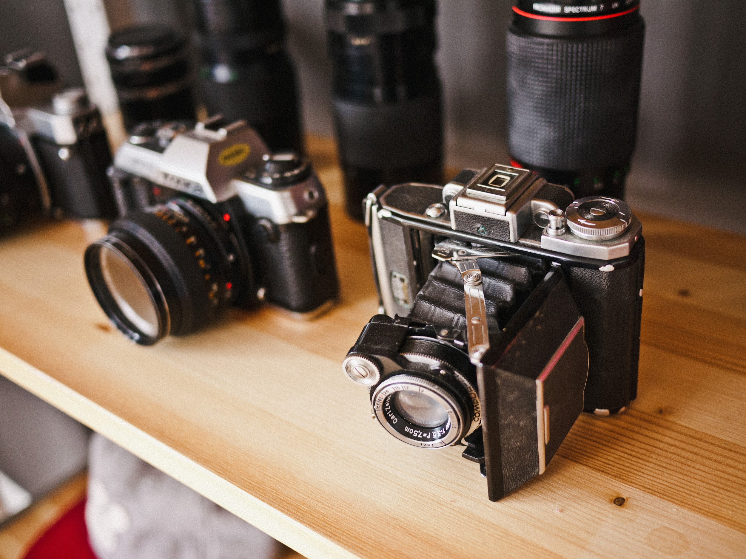



My Project
A digital marketing assistant performs a variety of duties that support the overall goals of a company's sales or marketing departments. In this career, I am responsible for carrying out tasks related to brand development and advertising strategies on digital platforms.

Slide 6
Education
Motijheel Model High School
Motijheel, Dhaka.
SSC-2017
Stamford College
Dhanmondi, Dhaka.
HSC-2019
Independent University Of Bangladesh (IUB)
Bashundhara, Dhaka.
BBA Marketing (Studied)

Slide 7
Reference
Kazi Aminur Rashid
Joint Director State Bank of Bangladesh
01927 550988, rashidkazi75@gmail.com
Md. Feroz Alam
Assistant Director
of Shonali Bank
01706 321822, ferozalamSB1983@gmail.com

Slide 8

Contact
Adiba Binte Amin
01990-427567, adiba-binte-amin1@hotmail.com
23/ kha k.M das lane, Motijheel, Dhaka-1203

